Slide 1
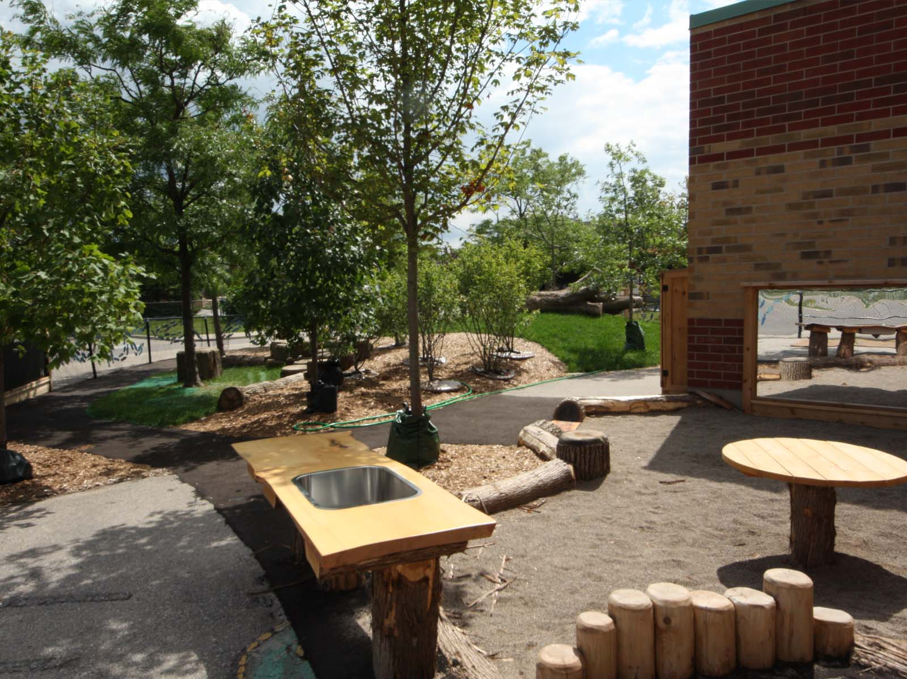
Welcome to St. Elizabeth Seton School
“Children learn as they play. Most importantly, in play children learn how to learn. ” ~ O. Fred Donaldson

Slide 2
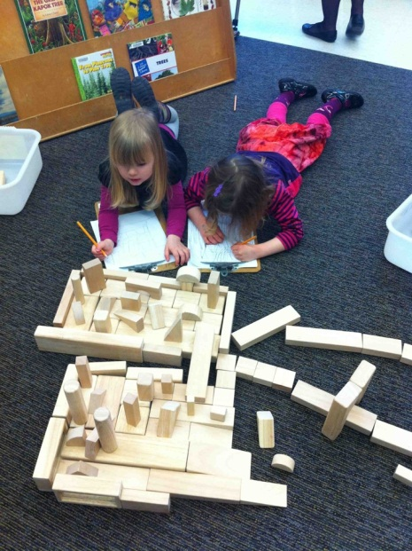
The School Day… This is only a sample of what your child’s school day may look like. You will receive more information in September.
8:25-8:40am- Morning drop off (Duty begins) Kindergarten gate/Kindergarten Kiss n Ride
8:40--9:00am- Entry/Attendance/Announcements/Prayers
9:00-10:00am- Outdoor Exploration
10:00-10:15am- Snack
10:15-11:55am- Gathering Time/Inquiry Learning
11:55-12:55pm- Lunch and Outdoor Exploration
12:55-1:45pm- Gym/Music/Dance/Visual Art/Library
1:45-2:15pm- Gathering time/Inquiry Based Learning/Centres
2:15-2:30 pm Snack
2:30-2:50pm- Gathering Time/Christian Meditation (Faith focus)
2:50—3:00pm- End of day sharing/Prepare for dismissal
3:00-3:10 pm Dismissal of Students
Notes:
Update with what your schedule may look like. Remember that there should be large blocks of time for Outdoor Play (it’s not recess but intentional play) and Indoor Play.
-movement breaks- gonoddle, yoga, etc
-meditation
-why we dismiss earlier-elevate congestion

Slide 3
Entry and Dismissal Procedures
Kindergarten educators are on duty beginning at 8:25am in the kindergarten yard
Parents are asked to remain outside the gated area
Students that are taking the bus will be met by an staff member and escorted to the Kindergarten yard
Pick up at the end of the day is between 3:00-3:10pm
One educator will walk the bus students onto the bus and escort the students to the YMCA after school program
Notes:
Discuss the procedures for your school regarding entry
It may be a good opportunity to talk about Punctuality and late procedures
Drop Off…quick kiss good bye
If your child is going to be away you must report the absence by calling the school

Slide 4
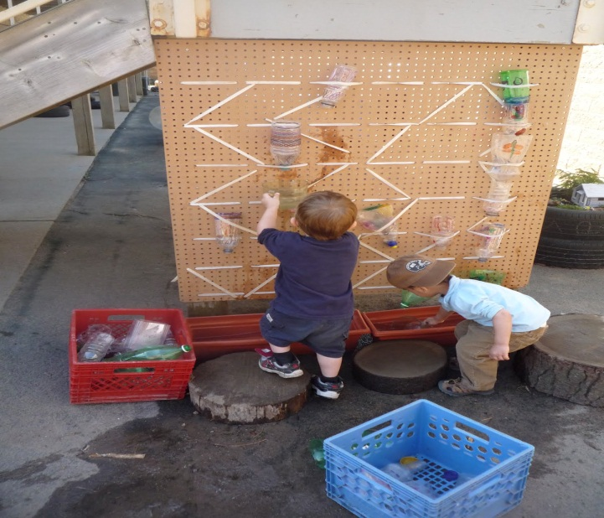
Before and After School Care
Offered by the YMCA
Seamless day
burlington.sacc@ymcahbb.ca
905-632-6300 x623
Hours: 7:00am-8:25am
3:10pm-6:00pm
Notes:
Edit to identify your childcare provider (either the YMCA or Parkview)
This is an opportunity for the childcare partners to speak about before and after school care.
Stress the importance of booking early
This message is on the Board Website under the “Parents” tab

Slide 5
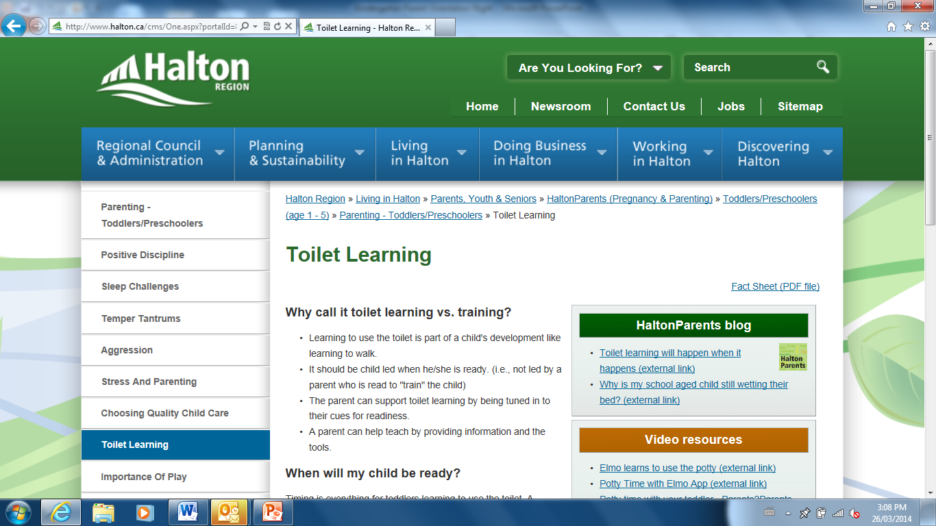
Establishing Routines…
Toileting Independence
Dressing and Undressing
Every child is different and every child learns at his or her own pace. Begin now to get your child comfortable with the idea of using the toilet. That way you have a good amount of time to guide your child, stop if you need to and begin again before school starts.
Notes:
If they are not yet toilet learning, this is a routine you want to establish. There is some helpful information available at Halton.ca http://www.halton.ca/cms/One.aspx?portalId=8310&pageId=61798
Children should be able to
Wipe
Flush
Wash their hands
Manage dressing and undressing
Dressing and undressing including outdoor clothing and shoes
Why call it toilet learning vs. training?
Learning to use the toilet is part of a child's development like learning to walk.
It should be child led when he/she is ready. (i.e., not led by a parent who is read to "train" the child)
The parent can support toilet learning by being tuned in to their cues for readiness.
A parent can help teach by providing information and the tools.
When will my child be ready?
Timing is everything for toddlers learning to use the toilet. A parent is often ready before a child is. Most children are physically, intellectually and emotionally ready to learn how to use the toilet when they are between the ages of two and three.
At this time in their development:
Children are developing physical control of their bladders and bowels.
They are able to understand where pee and poop should go and are developing awareness of the feeling of needing to use the toilet.
Toddlers are emotionally ready to learn by showing or expressing they are curious and want to learn.
Every child is different and every child learns at his or her own pace.
Top 3 tips to remember
Toilet learning should be child led - not parent led.
Keep it positive & fun even when accidents happen.
Be flexible and remember you may need to stop the process and try later if your child is showing little interest.

Slide 6
Educator Tips
Have your child practice opening and closing their lunch containers
Lunches and snacks should be labelled 1, 2, 3
Number 1 is their morning snack, number 2 is their main lunch, and number 3 is their afternoon snack
Have practice school lunches in the summer to give your child a chance to get used to their lunch bag, portions, and containers
Navy blue uniform shirts often work best due to the creative and messy nature of the kindergarten program
Kindergarten students spend a large part of the day outside and they need to always have appropriate clothing for the weather
Students need to always have a full set (including socks and underwear) of labelled spare clothes at school. Spare clothes don't necessarily need to be uniform items but similar colours work best ( a white or navy shirt and navy pants)

